Slide 1
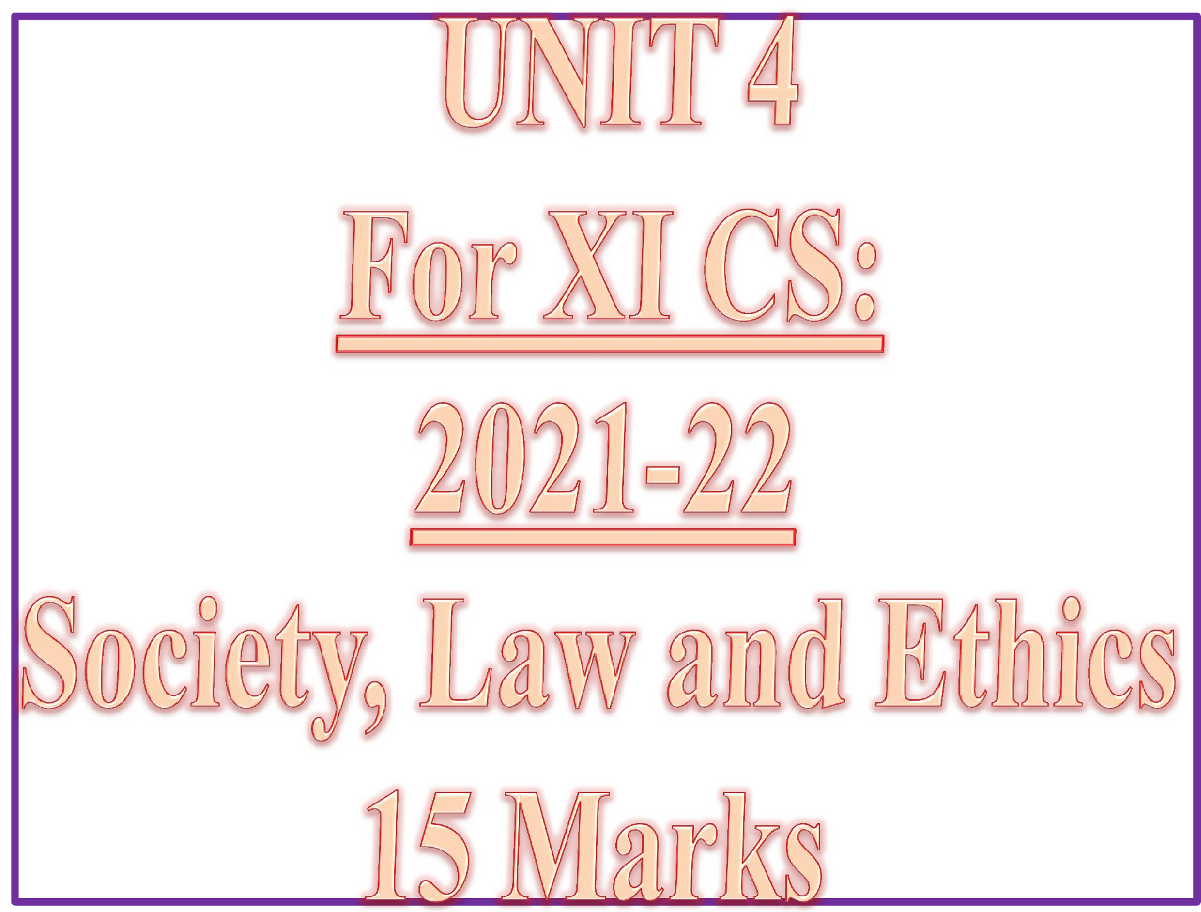

Slide 2
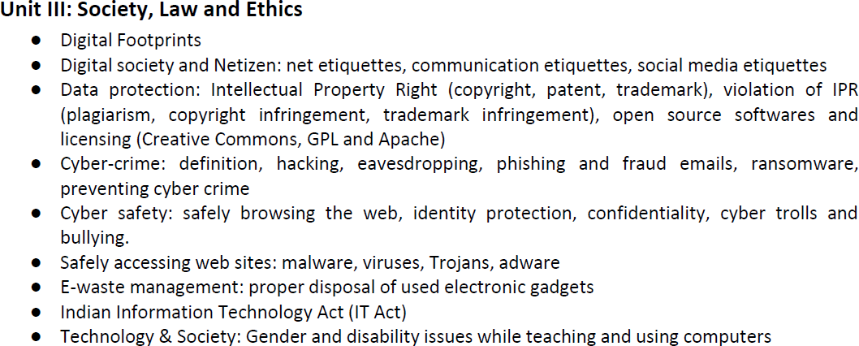
CONTENTS ( Learning Outcomes ) ☺
XI CSc 2021-22
In TERM-2 MARKS-15

Slide 3

Cyber Safety refers to the safe and responsible use of Internet to ensure safety and security of personal information and not posing threat to anyone else’s information.
It involves gaining knowledge about possible threat to personal safety and security risks for the information along with measures to prevent and counter them.

Slide 4
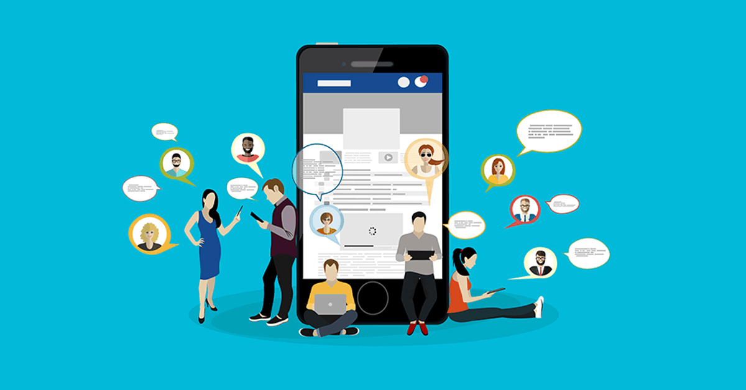
SOCIAL MEDIA ETIQUETTES
SAFELY BROWSING THE WEB
Are you posing/facing online dangers?
How will you avoid these dangers?
How to virtually behave /conduct yourself while browsing web?

Slide 5


Slide 6
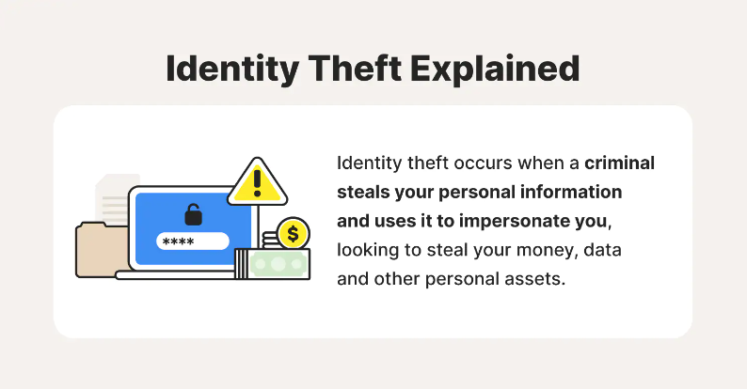

Slide 7
How do websites track you online ?
Various types of information used by websites to track us online are as follows:
IP Address — From our IP address, a website can determine our rough geographical location.
Cookies and Tracking Scripts — They can identify and track our browsing activity across a website.
HTTP Referrer — When a link to an outside website on a webpage is clicked, then the linked website will get opened and internally our information will be provided to the linked website.
Super Cookies — Super Cookies are persistent cookies that come back even after we delete them.
User Agent — It tells websites our browser and operating system, providing another piece of data that can be stored and used to target ads.

Slide 8
Private Browsing
:
Private Browsing is a concept of disabling the browser’s history, removing cookies, and not storing the web cache. The browser will not store browsing information (of the session) such as credentials of the user or the sites visited or the data you enter into forms if private browsing is enabled. Private Browsing doesn’t make you anonymous as your Internet Service Provider (ISP) will still be able to track you. Also, it is a common myth that it will protect users from keyloggers or spyware, but it will not.

Slide 9
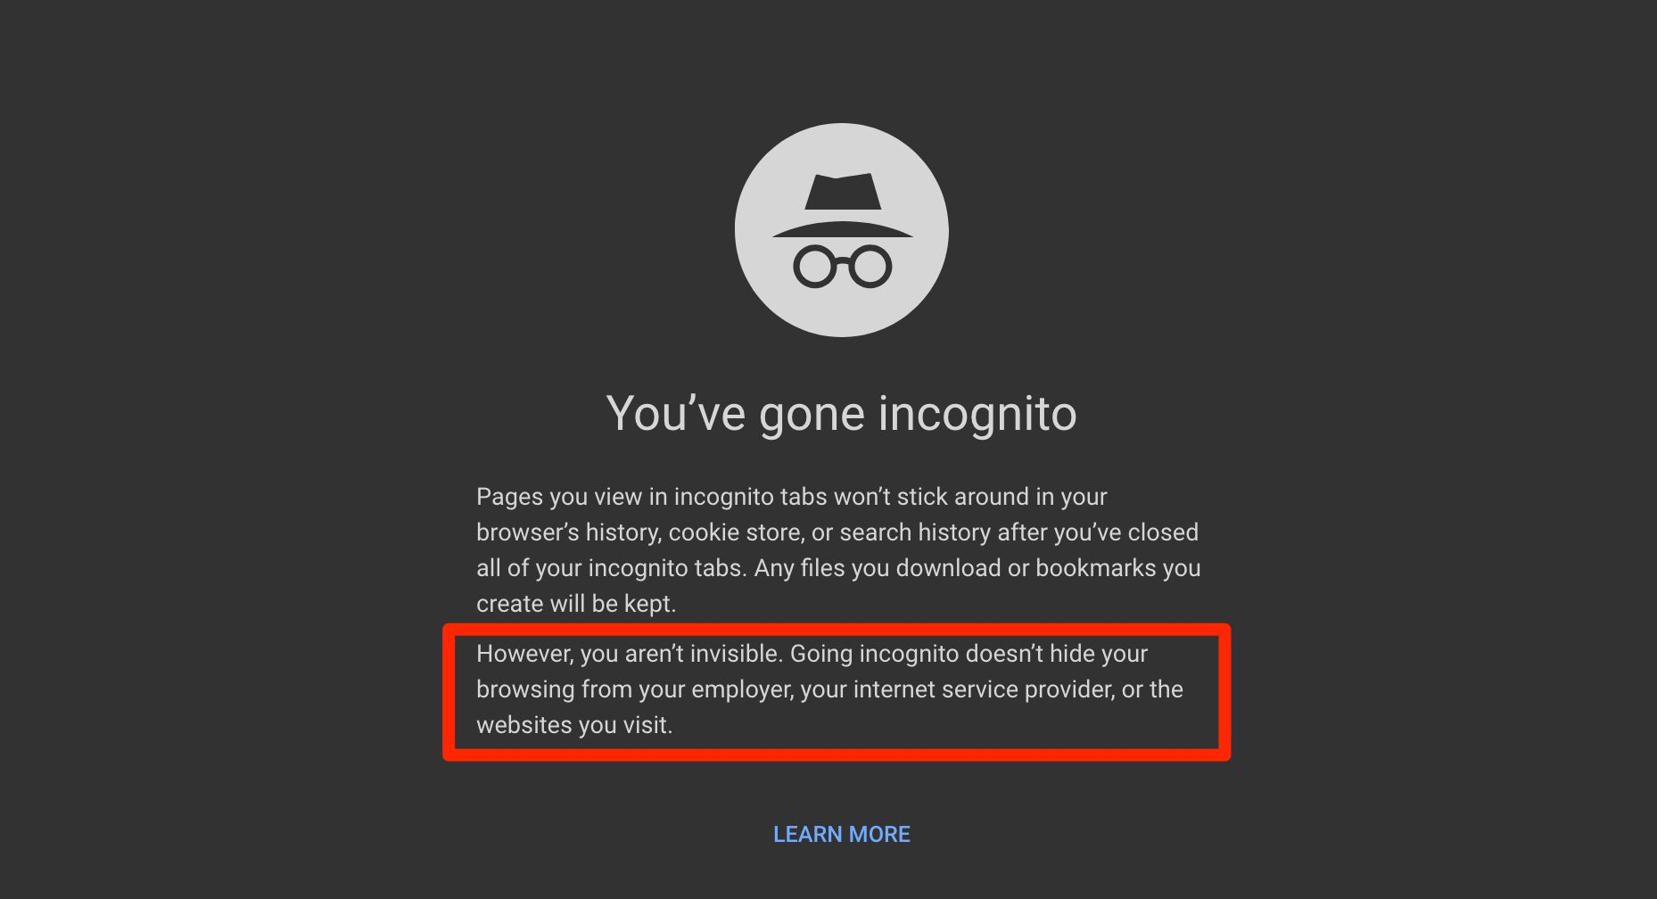
ANONYMOUS BROWSER
Anonymous browsers allow users to view websites without revealing any personal information like their IP address

Slide 10
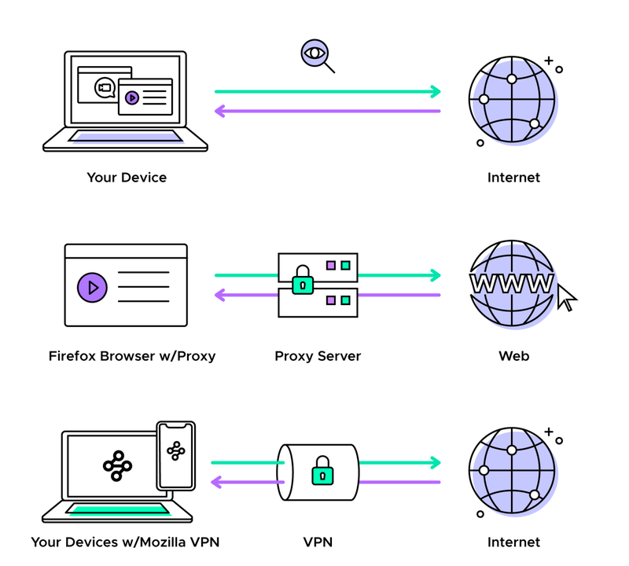

Slide 11

DATA PROTECTION
CONFIDENTIALITY OF INFORMATION
Ensures that only authorized users get access to sensitive and
protected data.

Slide 12
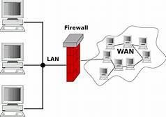
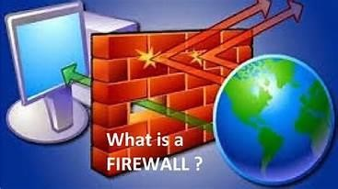



Practices to Ensure DATA PROTECTION
(Confidentiality of information)
Use firewall wherever possible
Control browser settings to block tracking
Browse privately wherever possible
Be careful while posting on Internet
Ensure Safe sites while entering crucial information
Carefully handle emails
Do not give sensitive information on wireless networks 8)
Avoid using public computers
Browse privately
Don’t save your login information
Never save passwords while working on a public computer
Avoid entering sensitive information onto a public computer
Don’t leave the computer unattended
Disable the feature that stores passwords
Properly log out before you leave the computer
Clear history and cookies.

Slide 13
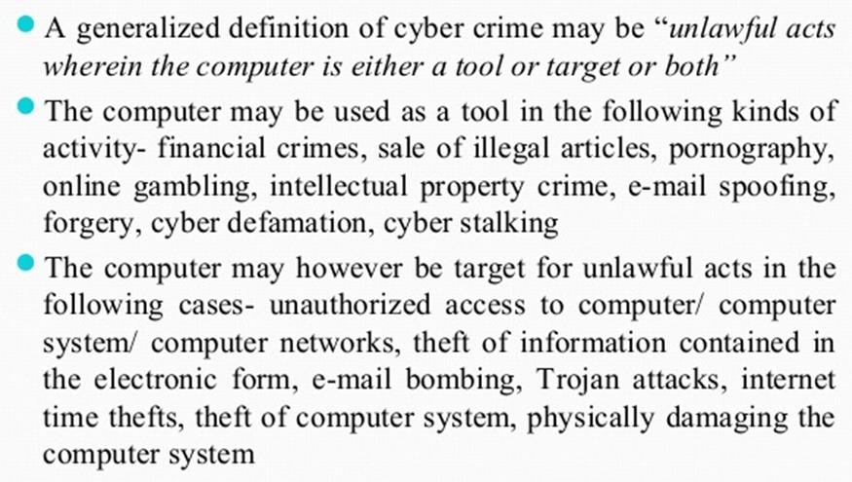
CYBER CRIME
Wikipedia

Slide 14
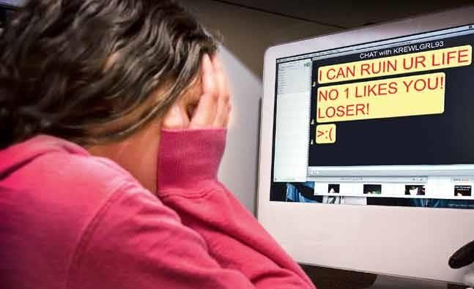
CYBER BULLYING
Harassing, demeaning, embarrassing, defaming or intimidating someone using modern technologies like Internet, cell phones, instant messengers, social networks etc. is called Cyber Bullying

Slide 15
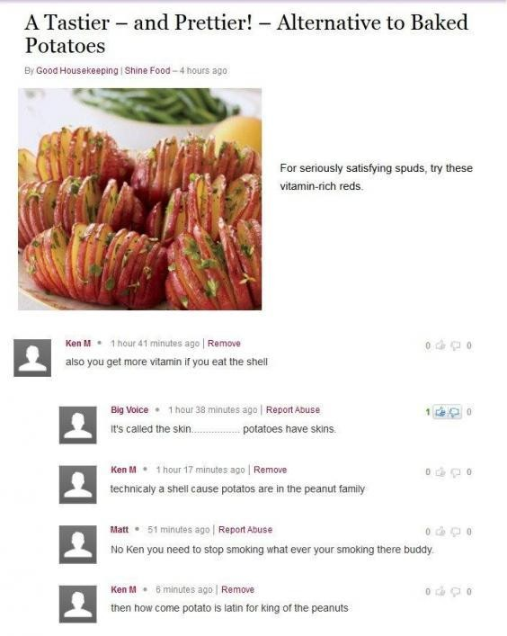
Cyber Trolls
Cyber Trolls refers to a person who purposely posts opposing, sarcastic,demeaning or insuting- comments about somethng or someone with an aim of targeting a person online.
Derogatory messages or comments posted online targeting people are called cyber trolls.
Cyber troll is a cyber crime closely related to cyber bullying.

Slide 16

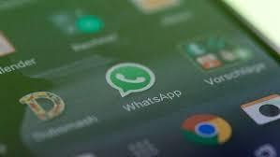
SPREADING RUMOURS ONLINE
People create fake profiles and indulge in posting false information on social media, or comments that could hurt others or spread rumours that may trigger panic or hurt religious sentiments of other people resulting into clashes and even riots etc.
Spreading rumours online is a cybercrime and is a punishable offence. As per IT Act of India, Publishing/circulation of Rumours, especially hurting religious sentiments is a cybercrime and may invite a fine with imprisonment extendable upto 3 years.

Slide 17
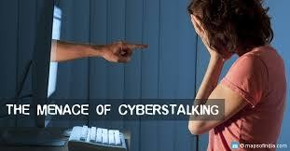
CYBER STALKING
Cyber stalking is a kind of online harassment wherein the victim is subjected to a barrage of online messages and emails.
The repeated use of electronic communications to harass or frighten someone, for example by sending threatening mails.
Cyberstalkers commonly have four objectives:
locate,
surveil,
emotionally harass,
and criminally manipulate their prey.
In some cases, the cyberstalker will prey on their target's family, friends, and coworkers to attack their target.
Examples of Cyberstalking:
Mark Zuckerberg has been stalked by Pradeep Manukonda

Slide 18
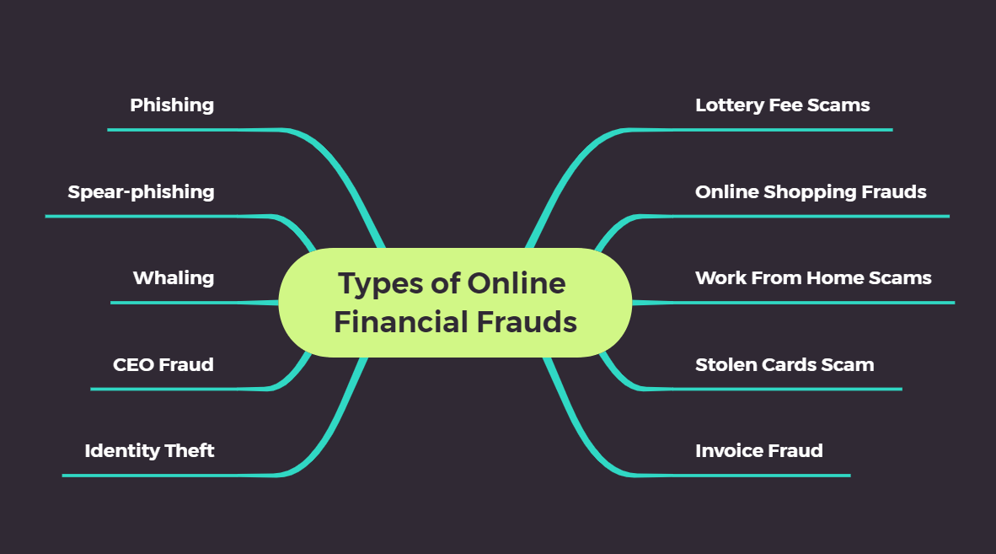
ONLINE FRAUD: FRAUD COMMITTED USING THE INTERNET IS CALLED ONLINE FRAUD

Slide 19
NET AND COMMUNICATION ETIQUETTES
What you should do- USAGE RULES
Be Authentic / honest ( Have honest and clear views, don’t boast)
Use a disclaimer (Your personal views are yours)
Don’t pick Fights Online (Constructive posts by choosing right words)
Don’t Use Fake Names or Pseudonyms (Be yourself)
Protect your Identity (NEVER provide your full name , parents’
details, phone no., address online)
Does your information/ Post pass the Publicity Test ?
Respect your audience (No slangs/obscenity/insults)
Respect other’s Sentiments (Respect others’ privacy and be
considerate to sensitive topics-Politics, Religion)
Monitor comments (Review and approve comments)

Slide 20
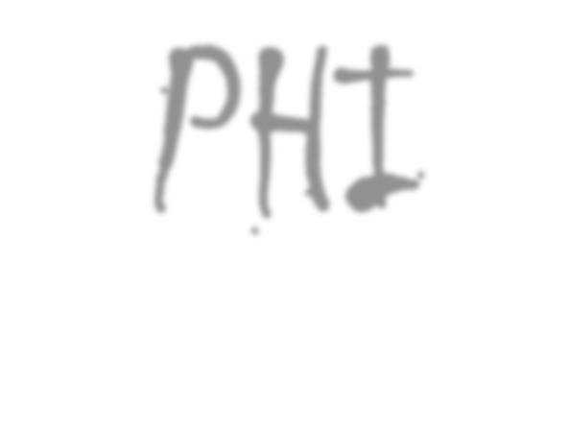

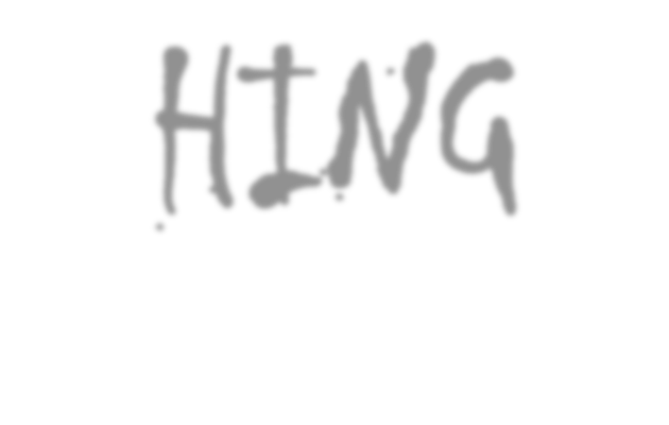
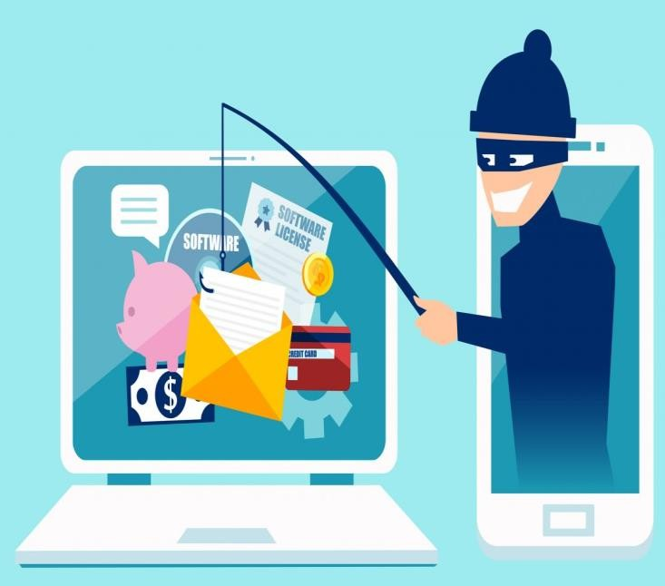
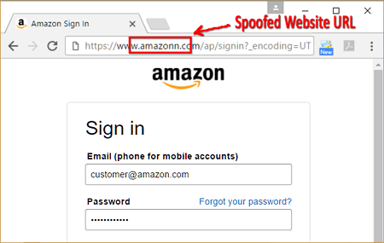
PfiISfiING
Phishing refers to a criminally fraudulent process of attempting to acquire sensitive information such as usernames, passwords, credit card information, account data etc.
In phishing , an imposter uses an authentic looking email or website to trick recipients into giving out sensitive personal information.

Slide 21
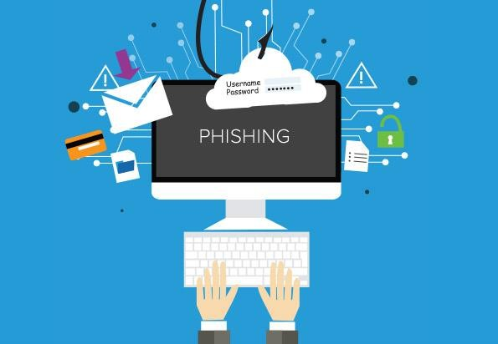
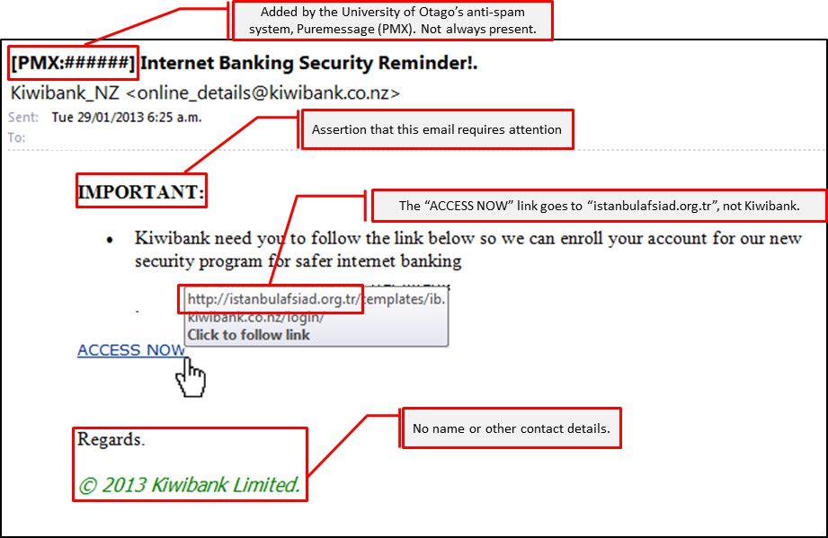

Slide 22
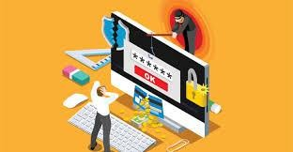

Slide 23
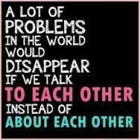

Slide 24
REPORTING CYBERCRIME
If any cybercrime happens , one must report it firstly to the members of his/her safety net (to parents, school authorities) and then to police. The procedure for reporting cybercrimes is more or less the same as for reporting any other kind of offence.
Local police stations can be approached for filing complaint just as the cybercrime cells.
Filing of ‘E-FIR’ in most of the states of India.
Launch of new website by Ministry of Home Affairs for registering crime against women and children online including cybercrimes

Slide 25
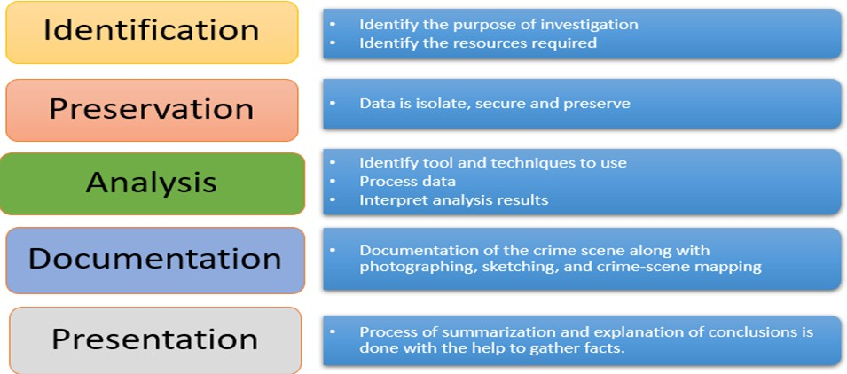

DIGITAL FORENSICS
Extra knowledge
“Digital forensics” is a broad term referring to the search for and detection, recovery and preservation of evidence found on digital systems, often for criminal or civil legal purposes.

Slide 26

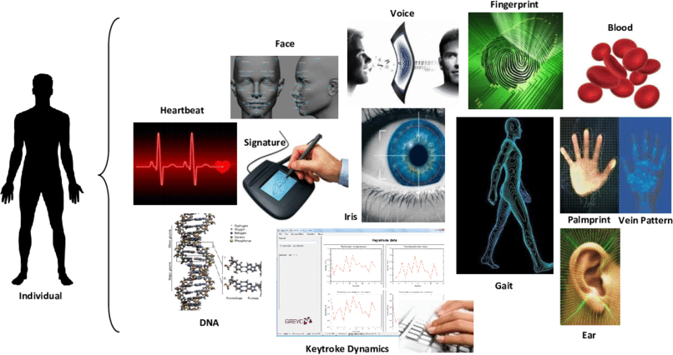
BIOMETRIC MODALITIES/TRAITS IN DIGITAL FORENSICS
to authenticate an individual

Slide 27

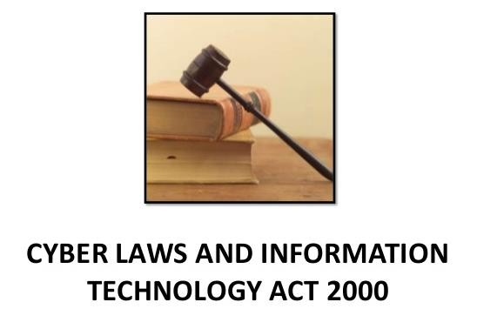
CYBER LAW / IT LAW
Cyber law, or cyber crime law,
is legislation focused on the acceptable behavioral use of technology including computer hardware and software, the internet, and networks.
Cyber law helps protect users from harm by enabling the investigation and prosecution of online criminal activity.
India’s IT Act 2000
In India, cyber laws are enforced through Information Technology Act,2000
It was notified on 17th October 2000.
It is based on United Nation’s Commission for International Trade related laws
(UNCITRAL) model law.
The purpose of IT Act is
  to provide legal recognition to electronic commerce (e-Commerce) and to facilitate filing of electronic records with the Government.
  To provide legal infrastructure for e-commerce in India.

Slide 28
IT(Ammedment) Act 2008
The Act was later amended in December 2008 to provide additional focus on information security i.e. IT Act, 2008. Major amendments are :-
Digital Signatures i.e. authentication of electronic records.
Electronic Governance i.e. E-documents get legal recognition.
Empowered Indian government with the ability to surveil, monitor and block data traffic .
The government will be able to conduct surveillance on corporate networks and e-mail systems, and can intercept, monitor and decrypt
computer systems, resources and communication devices.
The maximum penalty for any damage to computers is fine up to 1crore.
Other amended acts such as IPC 1860, 1872, 1891 and 1934.
The I.T. Act contains 13 chapters and 90 sections.
The last four sections namely sections 91 to 94 in the I.T. Act 2000 deals with the amendments to the Indian Penal Code 1860

Slide 29
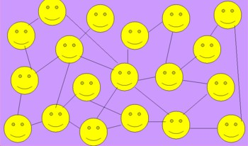


COMMON SOCIAL NETWORKING SITES
A social networking service (also social networking site, or SNS or social media) is an online platform which people use to build social networks or social relations with other people who share similar personal or career interests, activities, backgrounds or real-life connections.
People who have set up their profile on the same platform are called as online friends.

Slide 30
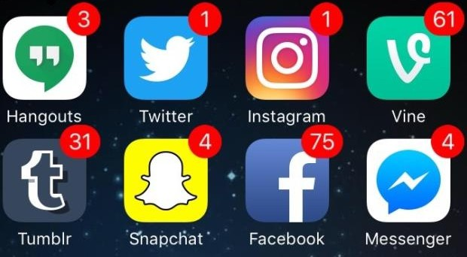


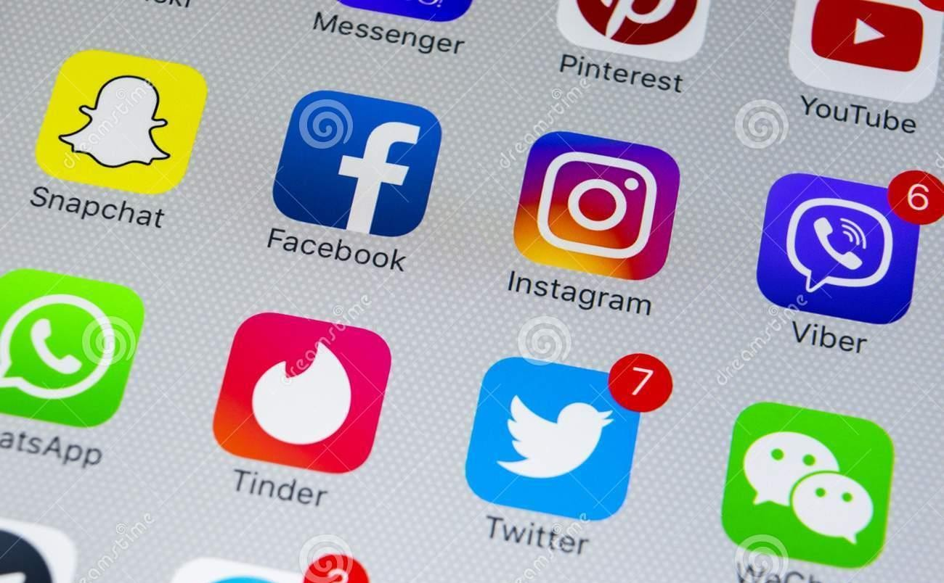

Slide 31


DIGITAL SOCIETY AND NETIZENS
A Digital Society is an interdisciplinary research area and a kind of progressive society that has been formed as a result of adaptation as well as integration of advanced technologies into the society and culture.
Digital innovations are reshaping our society, economy and industries with a scale and speed like never before.
Mobile and cloud technologies, Big Data and the Internet of Things offer
unimaginable opportunities, driving growth, improvement of citizens’ lives
and efficiency to many areas including health services, transportation, energy, agriculture, manufacturing, retail and public administration.

Slide 32

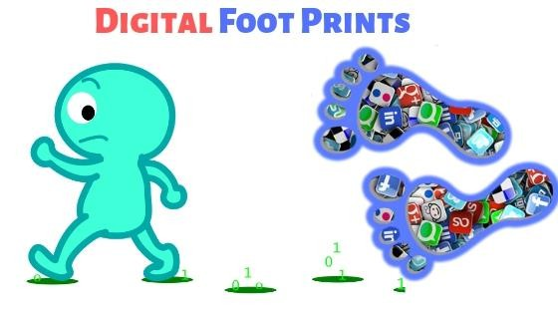

APPROPRIATE USAGE OF SOCIAL
NETWORKS :
DIGITAL FOOTPRINT
Our life is totally dependent on Social media- either directly or indirectly. But, if anyone thinks that he/she will remain entirely anonymous and pose a threat to others then, he/she is in absolute fool’s paradise. Let’s see how...
DIGITAL FOOTPRINT:
Whatever we do online, either post something or visit friends’ pages or search anything on Internet etc. leaves a permanent foot print and it remains for years storing trails of our online activities.
Digital footprints are the records and traces individuals’ activities which are stored permanently as they use the Internet. These footprints may pose potential threat / danger at a later stage in your personal/professional life.

Slide 33
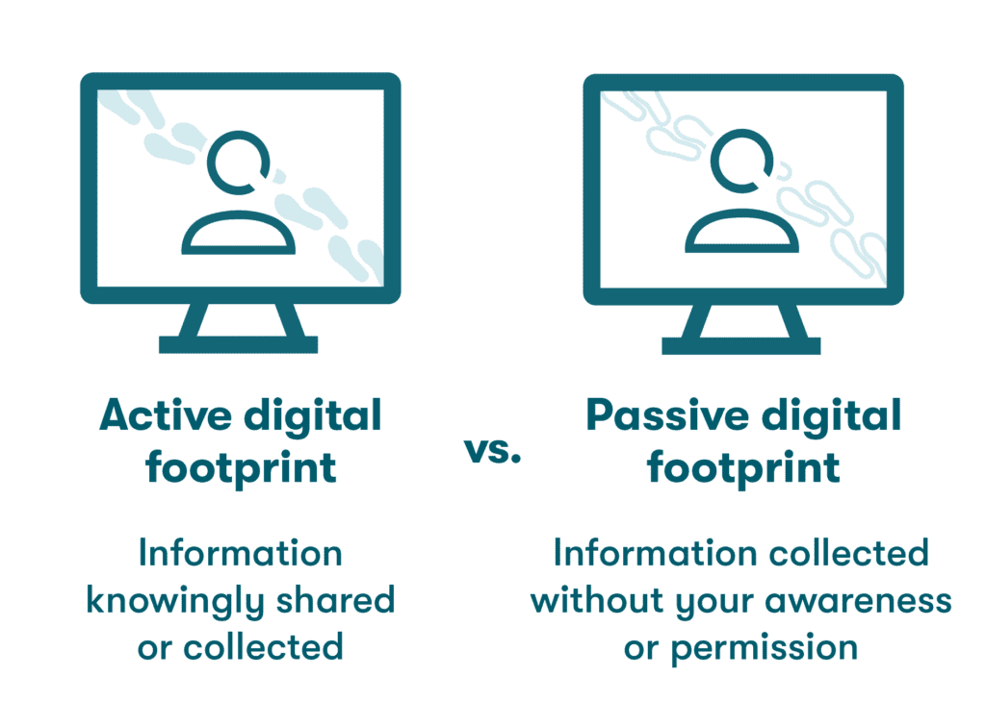

Slide 34

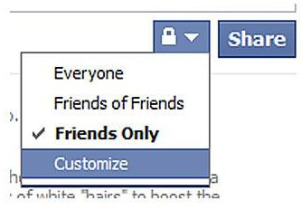
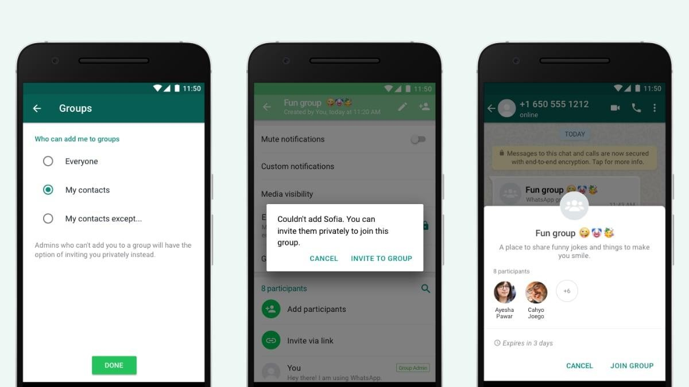
Privacy settings
Just remember to change the default privacy settings and set-up your own privacy settings for all types of social media platforms yourself, so that you can control,
Who all can see what you have posted
Who all can send requests to you
What all information about you is visible to others, even to your contacts etc.

Slide 35
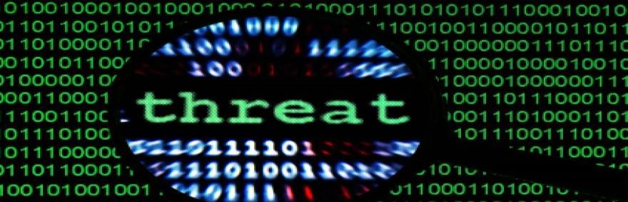
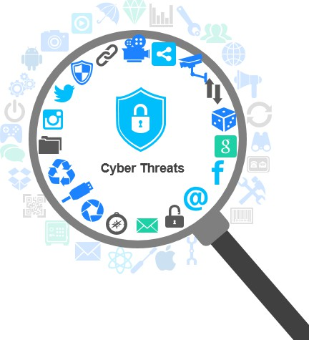
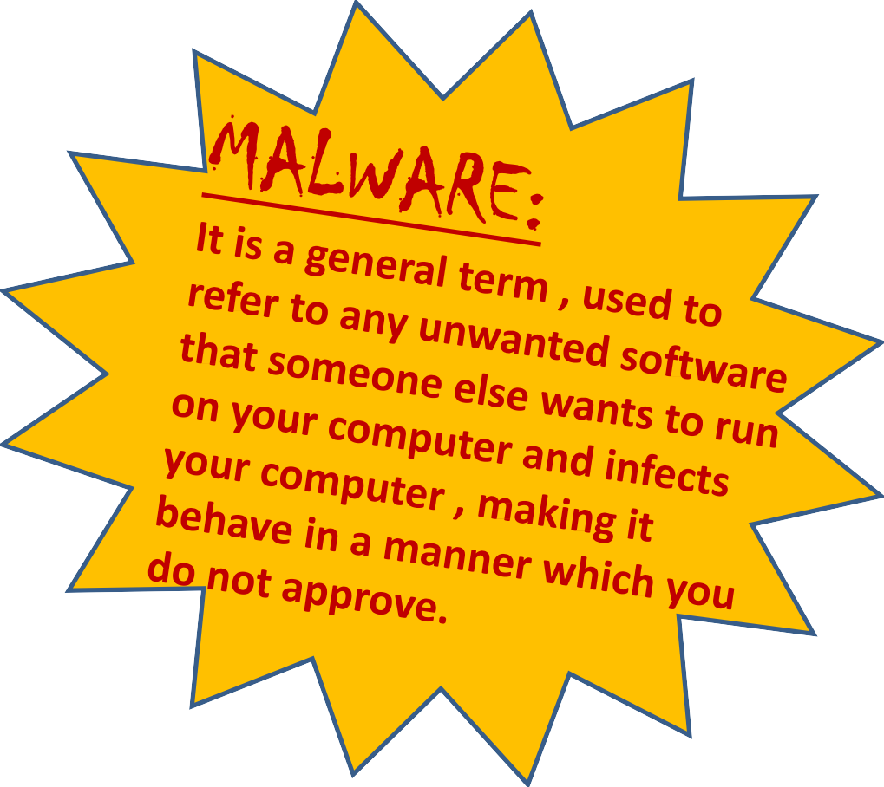
A threat is a potential violation of security. When a threat is actually executed, it is known as attack.
Some common threats (MALWARES):-
  Viruses ,Worms,Trojan Horse
  Spyware
  Adware
  Spamming
  PC Intrusion:
    Denial of Service
    Sweeping attack
    Password guessing
  Phishing

Slide 36
VIRUS: Computer viruses are malicious codes/ programs that cause damage to data and files on a system. It can attack any part of a computer’s software such as a boot block, OS, system areas, files and application-program-macros etc. It needs a host/ carrier application/program. Damages or deletes files Slow down your PC Invade your email program WORMS: It is a self-replicating program which eats up the entire disk space or memory and keeps on creating its copies until all the disk space or memory is filled. TROJAN HORSE: A Trojan horse is a program that appears harmless (such as a text editor/ screen saver or a utility program) but actually performs malicious functions such as deleting or damaging files at the background, which the user is usually unaware of. | Salient Differences
 | Computer Virus: Needs a host file Copies itself Executable
 | Network Worm: No host (self-contained) Copies itself Executable
 | Trojan Horse: No host (self-contained) Does not copy itself Imposter Program

Slide 37
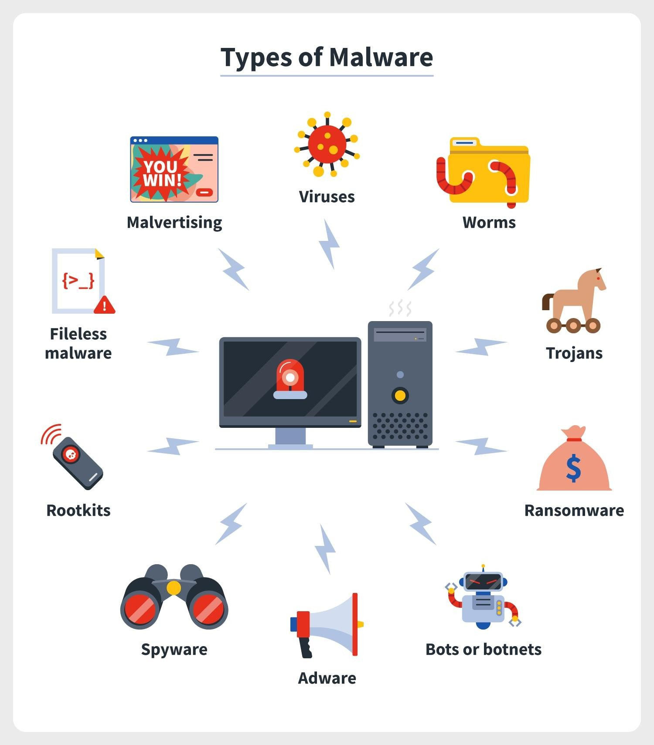

Slide 38
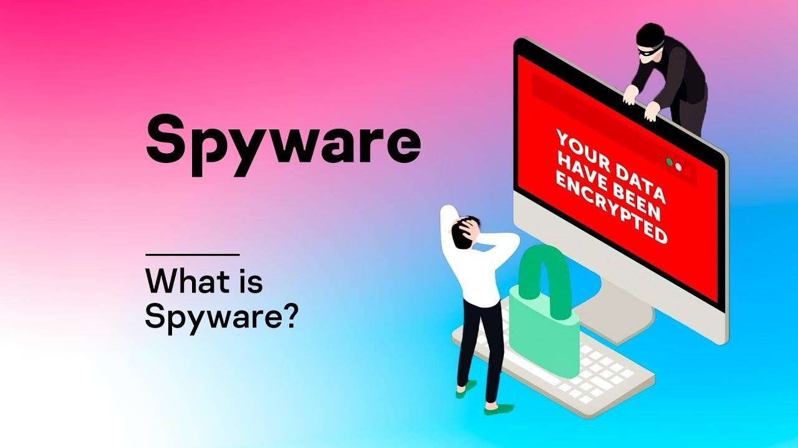
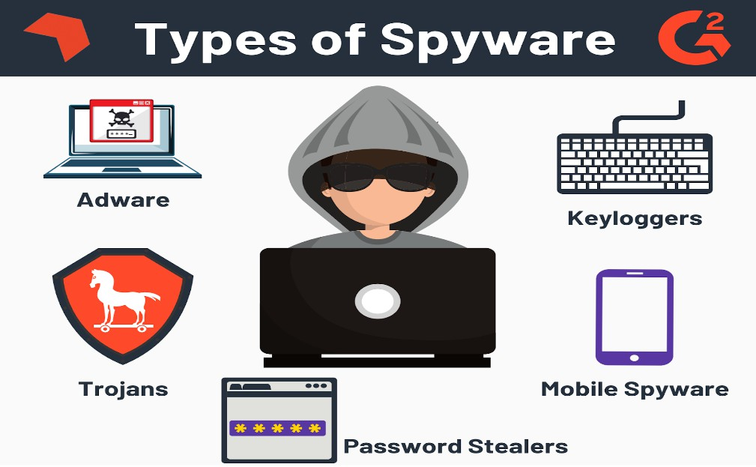
Spyware is software with malicious behavior that aims to gather information about a person or organization and send it to another entity in a way that harms the user.
For example, by violating their privacy or endangering their device's security.

Slide 39
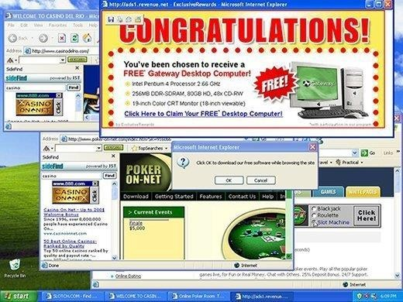
ADWARE
Adware is unwanted software designed to throw advertisements up on your screen, most often within a web browser.
Adware, often called advertising-supported software by its developers, is software that generates revenue for its developer by automatically generating online advertisements in the user interface of the software or on a screen presented to the user during the installation process.

Slide 40

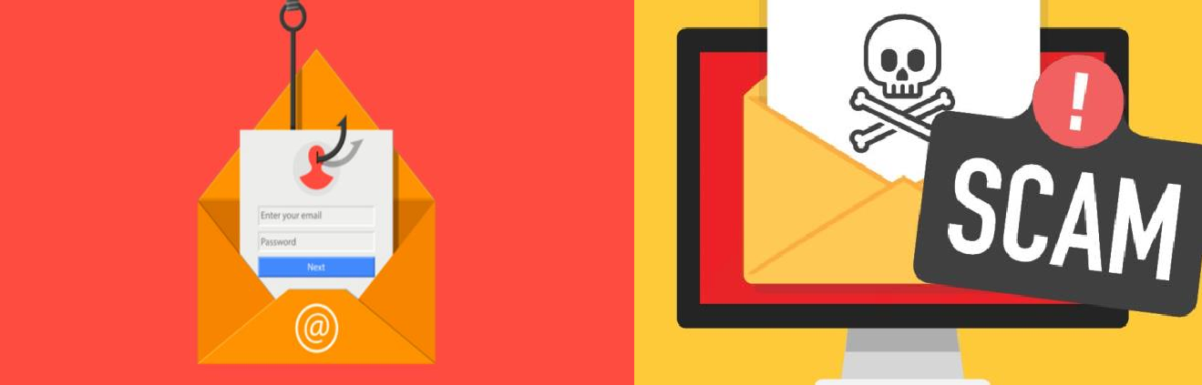
FRAUD EMAILS
Email fraud (or email scam) is intentional deception for either personal gain or to damage another individual by means of email. Almost as soon as email became widely used, it began to be used as a means
to defraud people.
Email fraud can take the form of a "con game", or scam. Confidence tricks tend to exploit the inherent greed and dishonesty of its victims. The prospect of a 'bargain' or 'something for nothing' can be very tempting.
Email fraud,' usually targets naive individuals who put their confidence in schemes to get rich quickly.
These include 'too good to be true' investments or offers to sell popular items at 'impossibly low' prices.
REMEMBER→ Many people have lost their life savings due to fraud. So, DON’T GET TRAPPED IN FRAUD EMAILS.

Slide 41
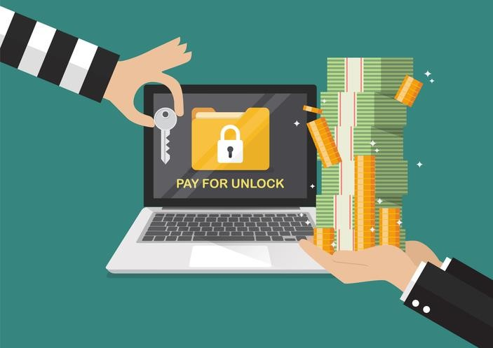
RANSOMWARE
Ransomware is malware that infects devices and locks users out of their data or applications until a ransom is paid. This is costly for businesses because they may have to pay a large sum of money to regain access to their files. It has been revealed that some users have paid enormous fees to obtain the decryption key.

Slide 42


Slide 43










About: FREE and OPEN Source Software (FOSS)
Some Related Terms
Free Software:-
It means the s/w is free of cost which is freely accessible and can be freely used, changed, copied and distributed by all who wish to do so.
Open Source Software(OSS):-
An open software is also available freely i.e its source code is available freely and one can make modifications to it and can redistribute it with different name. But if anyone wants for solution of problem on the existing s/w by the manufacturer, it will not be free (it will be with some nominal charges)
FLOSS(Free Libre Open Source Software):-
A Software which is both free of cost and Open source software i.e. source code is available.
4) Proprietary Software):-
A Software which is neither free of cost nor available for Public. There is a proper license attached to it which user has to buy in order to use it.

Slide 44




About: FREE and OPEN Source Software (FOSS)
Some Related Terms
Shareware / Trialware / Demoware:-
  This software is made available with the rights to distribute copies, but if anyone intends to use the software , then after a certain stipulated time period, a license fee should be paid.
  Its source code is not allowed and hence its modification is not allowed. “Trial version before you buy it”.
Freeware
  This software is free of cost.
  It allows copying and further distribution, but still under owner’s control, i.e. Copyrighted.
  Its source code is not available, hence no modification is possible.

Slide 45

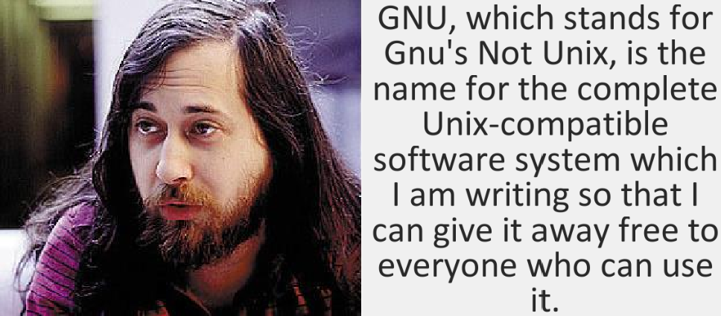

About: FREE and OPEN Source Software (FOSS)
Some Related Terms
GNU stands for
(GNU’s not Unix) ;-
Here, GNU means an animal which is living in freedom. It is a free operating system
identical to Unix but not Unix.
GNU’s Not Unix is a recursive acronym.
FSF(Free Software Foundation) It is a non-profit organization
Richard Stallman
created for the purpose of supporting free s/w movement. It also funds many programmers for developing free s/w.
FSF and GNU both were initiated by Richard Stallman.

Slide 46
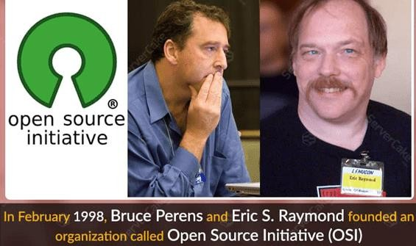

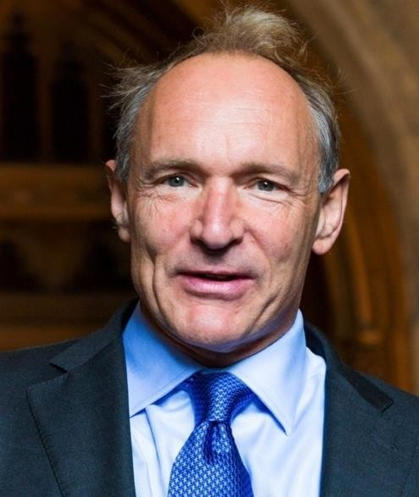
About: FREE and OPEN Source Software (FOSS)
Some Related Terms
OSI(Open Source Initiative It is an organization developed for promoting Open source software. It defines criteria and terms for open
source s/w.
W3C (World Wide Web Consortium) :-
It is responsible for producing the s/w standards for world wide web. The World Wide Web Consortium (W3C) is the main international standards organization for the World Wide Web. Founded in 1994 and currently led by Tim Berners-Lee, the consortium is made up of member organizations that maintain full-time staff working together in the development of standards for the World Wide Web. W3C also engages in education and outreach, develops software and serves as an open forum for discussion about the Web.
Tim Berners-Lee

Slide 47
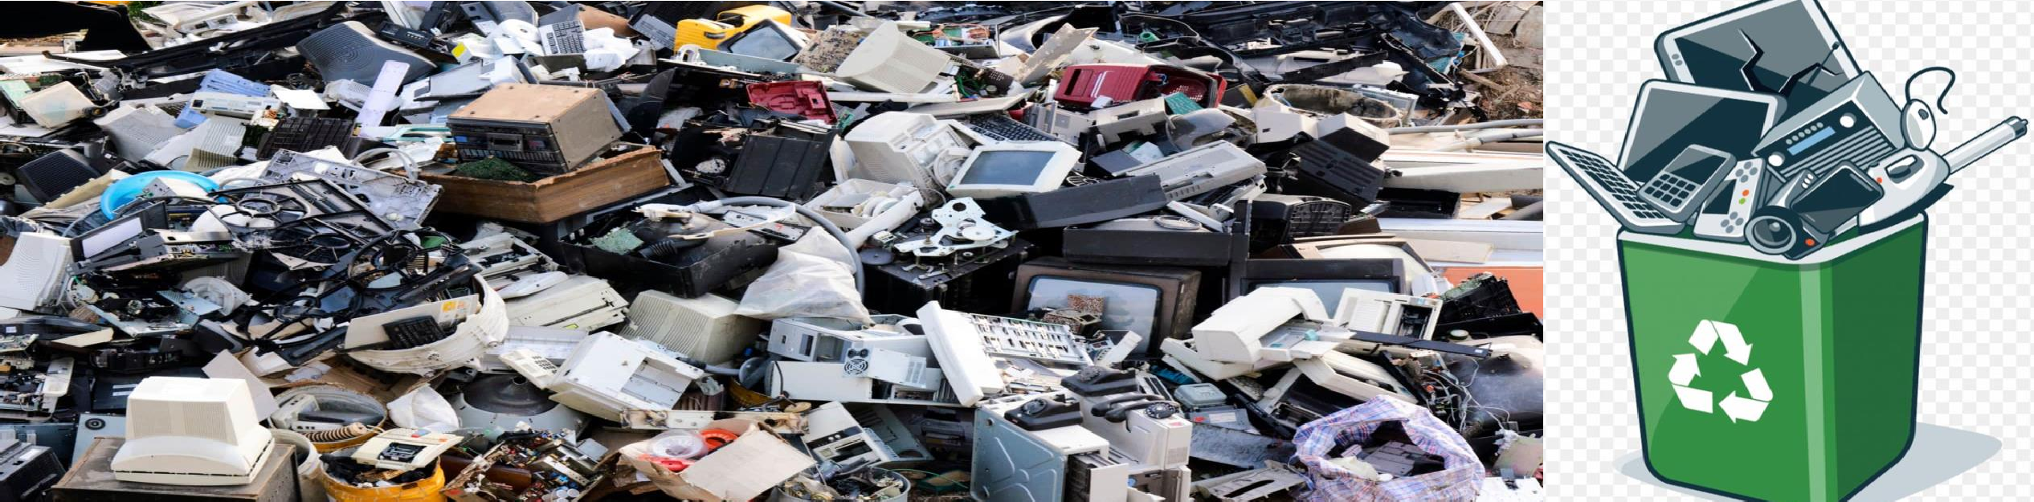
E-WASTE MANAGEMENT
➢
E-Waste: Electronic waste describes discarded electrical or
electronic devices. “Electronic waste” may also be defined as discarded computers, office electronic equipment, entertainment device electronics, mobile phones, television sets and refrigerators. This includes used electronics which are destined for reuse, resale, salvage, recycling or disposal.
Electrical and Electronic equipment contains metallic and non metallic elements such as Copper, Aluminum, Gold, Silver, Palladium, Platinum, Nickel, Tin, Lead, Iron, Sulphur, Phosphorous, Arsenic etc.

Slide 48

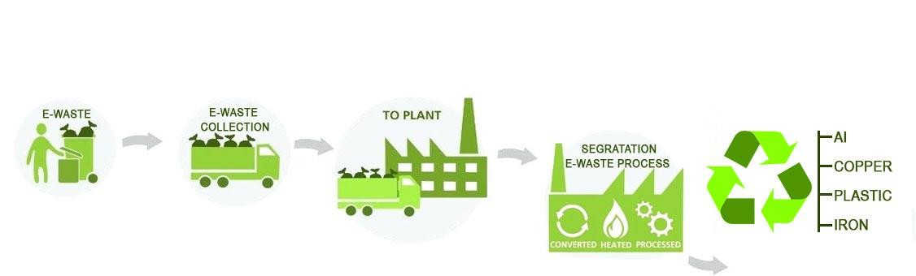
The recycle and recovery includes the following unit operations
Dismantling involves removal of parts containing dangerous substances, parts containing valuable substances.
Separation of ferrous metal, non- ferrous metal and plastic.
Repair and reuse.
Recovery of valuable materials.
Disposal of dangerous materials.
The e-waste disposal and recycling is very much necessary and important for the benefit of people, environment and the nation.
The key benefits are:-
Allows for recovery of valuable precious
metals
Protects public health and water quality.
Creates jobs
Toxic waste
Saves landfill space.

Slide 49
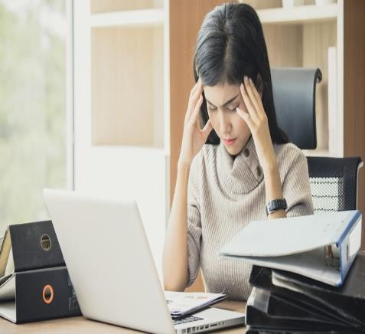
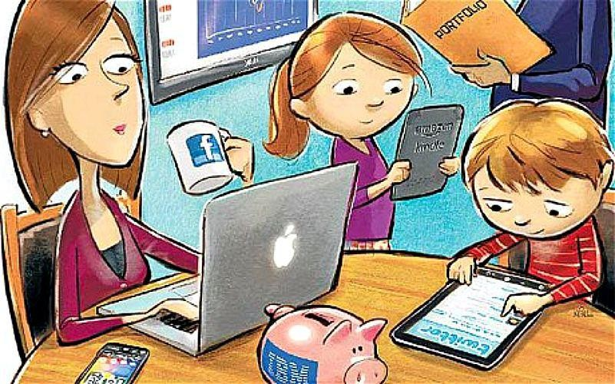
Awareness about health concerns related to the usage of Technology
1. Digital eye strain
Symptoms of digital eye strain may include:
Negative effects of technology on kids: Too much screen time or low- quality screen time may lead to
  behavioral problems
  less time for play and loss of social skills
  obesity
  sleep problems
blurred vision
dry eyes
headaches
neck and shoulder pain
Violence
Emotional problems
makes you feel anxious or depressed
Sleep problems
Musculoskeletal problems
When you use a Smartphone, the chances are that you’re holding your head in an unnatural forward-leaning position. This position puts a lot of stress on your neck,shoulders, spine and repetitive strain injuries of the fingers,thumbs,and wrists.

Slide 50
MEASURES TO SAFEGUARD FROM NEGATIVE TECHNOLOGICAL EFFECTS
Clear your phone of unessential apps to keep you from constantly checking it for updates.
Take frequent breaks to stretch, create an ergonomic workspace and maintain proper posture while using devices
Carve out a specific, limited amount of time to use your devices.
Turn some television time into physical activity time.
Keep electronic devices out of the bedroom. Charge them in another room. Turn clocks and other glowing devices toward the wall at bedtime.
Make mealtime gadget-free time.
Prioritize real-world relationships over online relationships.
CHECK OUT else you will be WIPED OUT:-
Technology is a part of our lives. It can have some negative effects, but it can also offer many positive benefits and play an important role in education, health, and general welfare.
Knowing the possible negative effects can help you take steps to identify and minimize them so that you can still enjoy the positive aspects of technology.

Slide 51


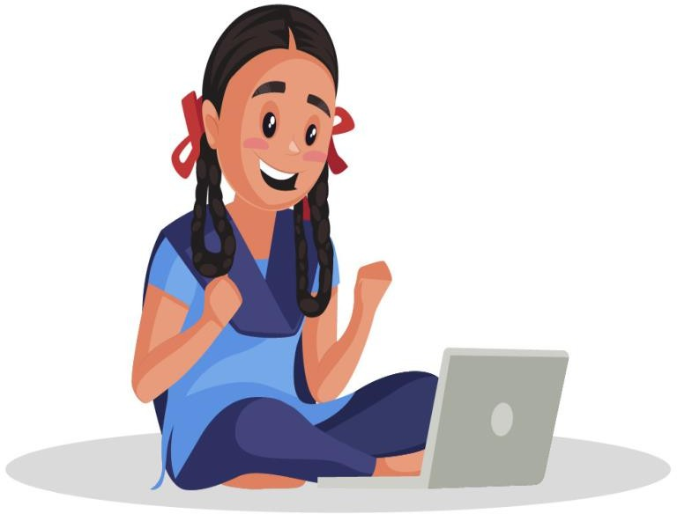
GENDER ISSUES WHILE TEACHING AND USING COMPUTERS
There are several Gender specific issues which must be addressed and taken care of to enforce gender equality in Computer Science education.
Some Gender issues are:-
Lack of representation(under representation) of Females in school (less no. of female teachers in schools)
Lack of motivation and interest in the subject
Lack of Female Role models /leaders /personalities
Lack of encouragement in classroom environment
Preconceived notions / Gender stereotypes/unconscious bias
Lack of Girl Friendly Work culture

Slide 52
SOLUTIONS TO GENDER ISSUES
Take initiatives and encourage more and more girls to take up the subject “Computer Science” as their main subject.
In Computer Labs, give more chance to girls to work on computers by avoiding Gender biasness
Use Gender neutral language in school
Representation of Females in every field and encouraging them to take interest in IT field
Motivate girls to become role models in IT field.

Slide 53
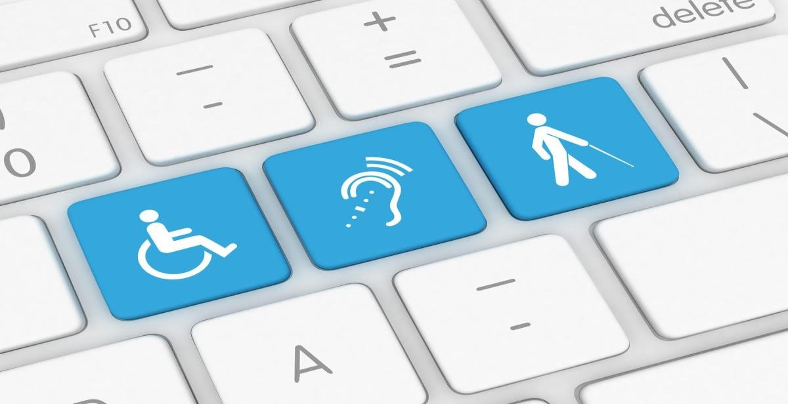
DISABILITY ISSUES WHILE TEACHING AND USING COMPUTERS
Some disability issues are:-
Unavailability of proper teaching aids/materials to teach disabled students (such as braille keyboards,monitors,printers,screen readers, hearing aids etc.)
Lack of special needs teachers to teach and train the differently abled students-
specialized editors,voice assistant softwares etc.
Lack of supporting curriculums in school
Solutions to disability issues are:-
School must be equipped with necessary assistivetools and software and teaching materials
Specially Trained teachers must be appointed
Curriculums must be framed carefully by keeping in mind the specially abled students.
Inclusive education must be promoted in classrooms

Slide 54
Bibliograhy and References
Google
Wikipedia
Quora
geektogeeks
Book: XI Computer Science
  By Sumita Arora, Dhanpat Rai Publication 2020 Edition
Book: XI Computer Science
  By Kips Publication 2021 Edition

Slide 55


Stay safe. Stay aware. Stay healthy. Stay alert.

Slide 56







